Slide 1
EEE 109 Electrical Circuits
Dr. Md. Forkan Uddin
Associate Professor
Department of Electrical and Electronic Engineering (EEE)
Bangladesh University of Engineering and Technology (BUET)

Slide 2
Network Theorems
Boylestad – Chapter 9

Slide 3
Topics to be Covered
Superposition Theorem
Thevenin’s Theorem
Norton’s Theorem
Maximum Power Transfer Theorem

Slide 4
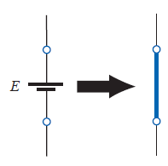
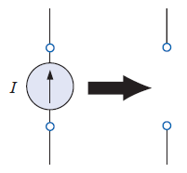
Superposition Thorem
The current through, or voltage across, an element in a linear bilateral network is equal to the algebraic sum of the currents or voltages produced independently by each source
Deactivating Sources:
Voltage Source: Short Circuit
Current Source: Open Circuit

Slide 5
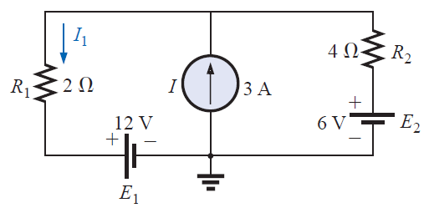
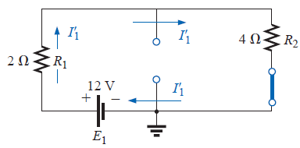
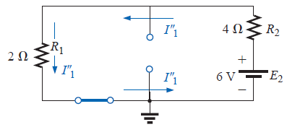
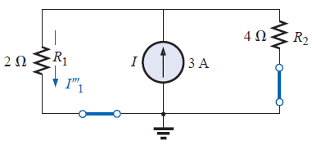




Superposition Principle
Example: Calculate I₁

Slide 6
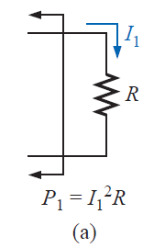
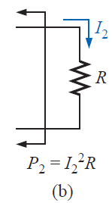
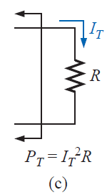


Superposition Principle: Power
Superposition Principle is not true for calculating power (as power is a non-linear quantity of voltage or current)
Proof:
(if P_{T} had followed superposition)
On the other hand,

Slide 7
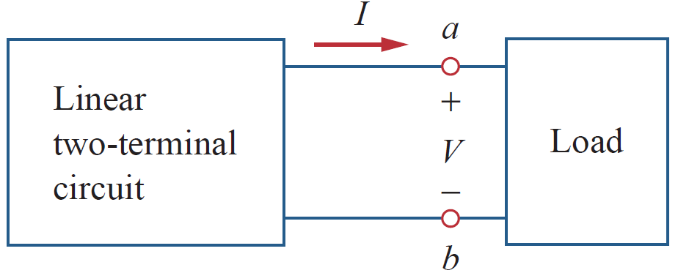
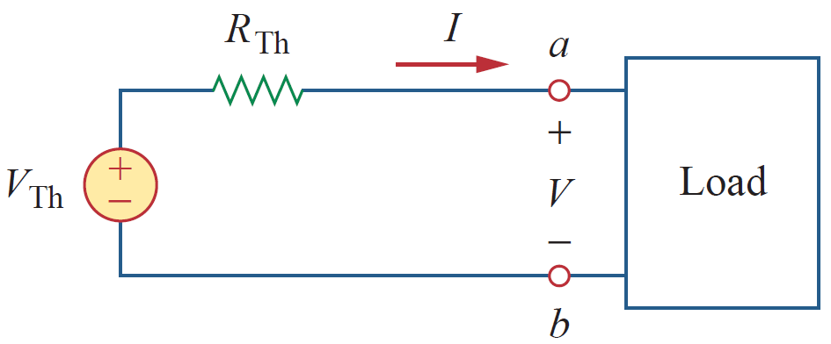
Thevenin’s Theorem
Any two-terminal, linear bilateral dc network can be replaced by an equivalent circuit consisting of a voltage source and a series resistor
V_{Th} = Thevenin Voltage
R_{Th} = Thevenin Resistance

Slide 8
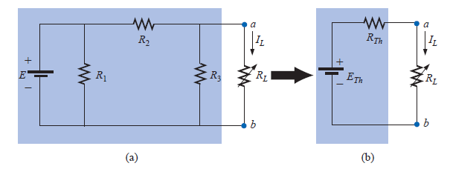
Thevenin’s Theorem
Usefulness of Thevenin’s Theorem
allows us to find any particular voltage or current in a linear network with one, two, or any other number of sources
we can concentrate on a specific portion of a network by replacing the remaining network with an equivalent circuit.

Slide 9
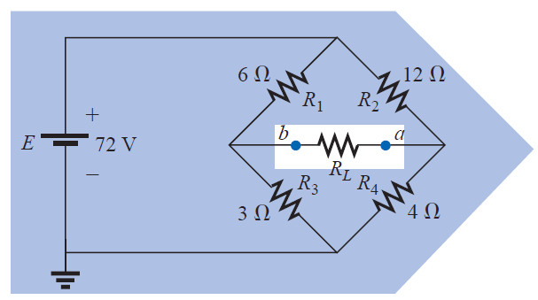
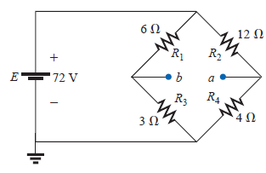

How to find Thevenin Equivalent Circuit?
R_{L} = 5 ohm
Procedure
1. Remove that portion of the network across which the Thevenin equivalent circuit is to be found
2. Mark the terminals of the remaining two-terminal network
3. Calculate R_{Th} by first setting all sources to zero and then finding the resultant resistance between the two marked terminals
4. Calculate E_{Th} by first returning all sources to their original position and finding the open-circuit voltage between the marked terminals
5. Draw the Thévenin equivalent circuit with the portion of the circuit previously removed replaced between the terminals of the equivalent circuit
I_{ab} = ?
V_{ab} = ?
R_{Th}

Slide 10
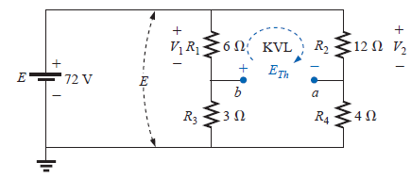
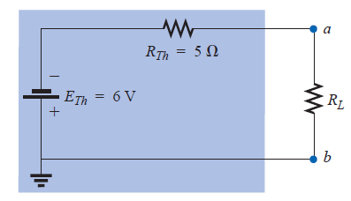
Thevenin Equivalent Circuit
E_{Th}
Thevenin Equivalent Circuit
I_{ab} = - 0.6 A
V_{ab} = - 3V

Slide 11
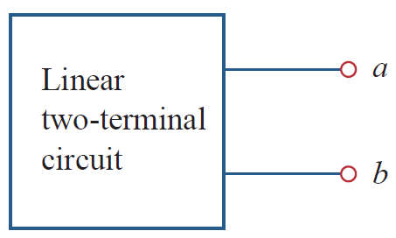
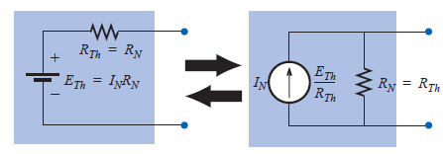
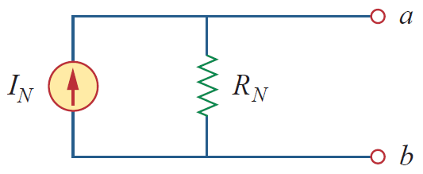
Norton’s Theorem
Any two-terminal, linear bilateral dc network can be replaced by an equivalent circuit consisting of a current source and a parallel resistor
Converting between Thevenin and Norton equivalent circuits
I_{N} = Norton Current
R_{N} = Norton Resistance

Slide 12
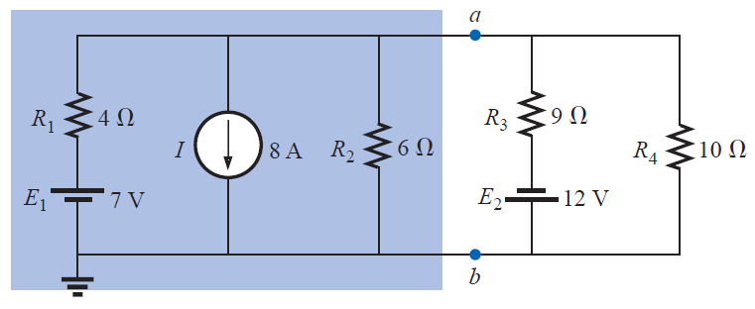
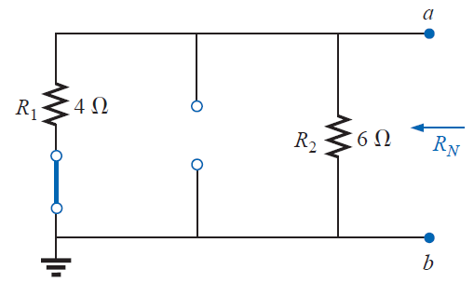

Norton’s Theorem
Procedure
1. Remove that portion of the network across which the Norton equivalent circuit is to be found
2. Mark the terminals of the remaining two-terminal network
3. Calculate R_{N} by first setting all sources to zero and then finding the resultant resistance between the two marked terminals
4. Calculate I_{N} by first returning all sources to their original position and finding the short-circuit current flowing between the marked terminals
5. Draw the Thévenin equivalent circuit with the portion of the circuit previously removed replaced between the terminals of the equivalent circuit
R_{N}

Slide 13
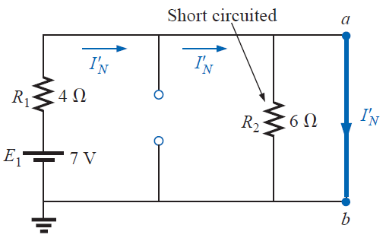
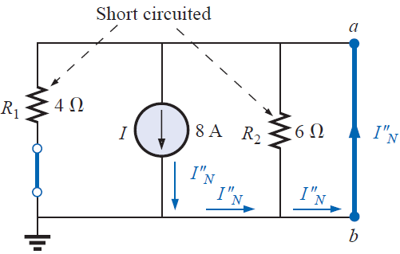


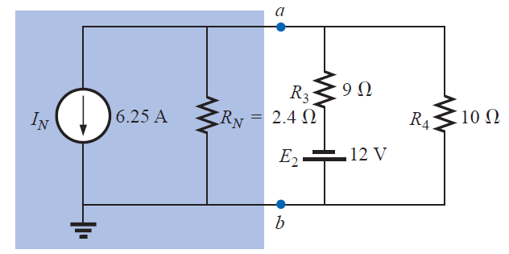
Norton’s Theorem
I_{N}
Norton Equivalent Circuit

Slide 14
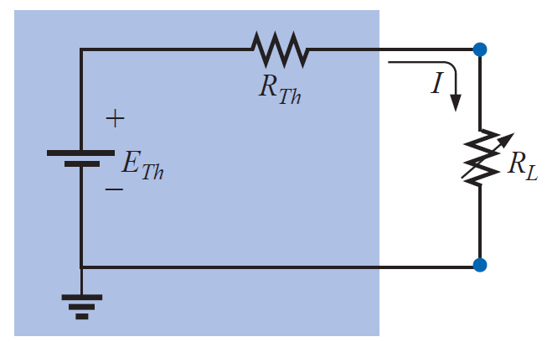
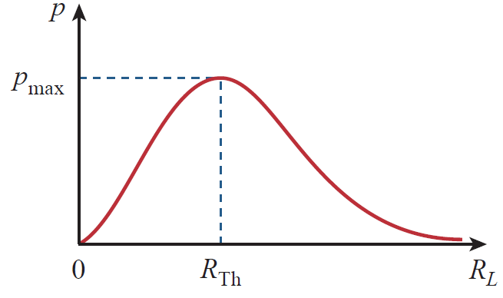


Maximum Power Transfer Theorem
A load will receive maximum power from a linear bilateral dc network when its total resistive value is exactly equal to the Thevenin (Norton) resistance of the network as “seen” by the load

Slide 15
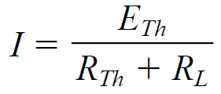
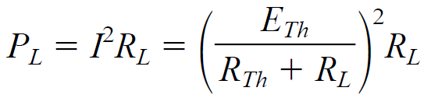
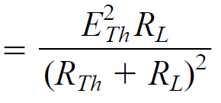
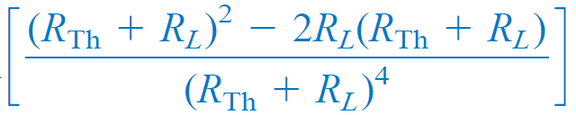
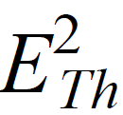



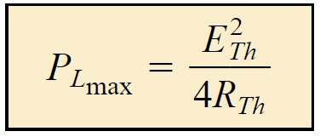
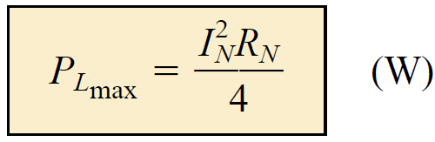
Maximum Power Transfer Theorem
Proof

Slide 16
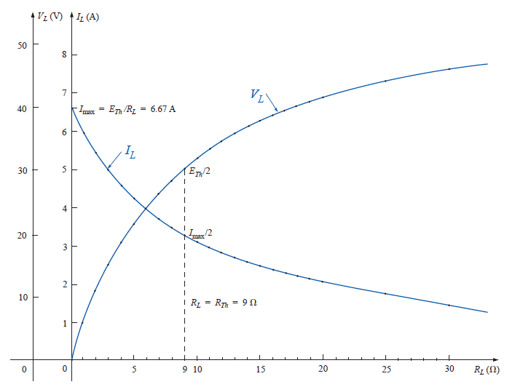
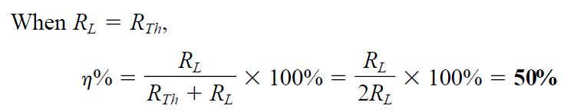
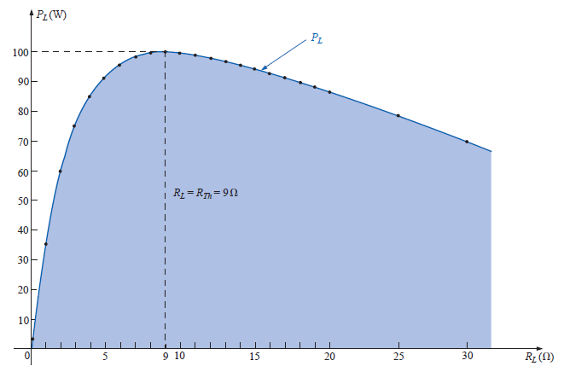
More on Maximum Power Transfer Theorem

Slide 17
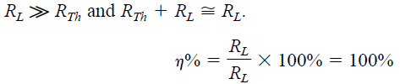
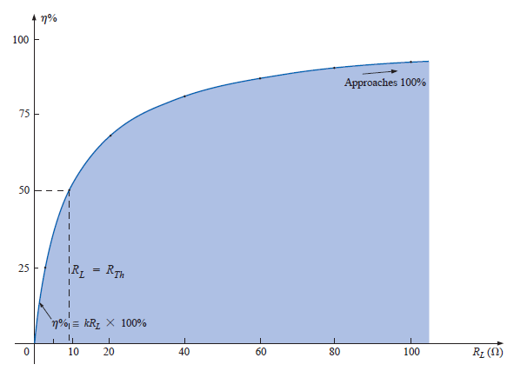
More on Maximum Power Transfer Theorem
Efficiency and Maximum Power Transfer Theorem
Efficiency is increasing, but power at load is decreasing.
Is it contradictory?

Slide 18
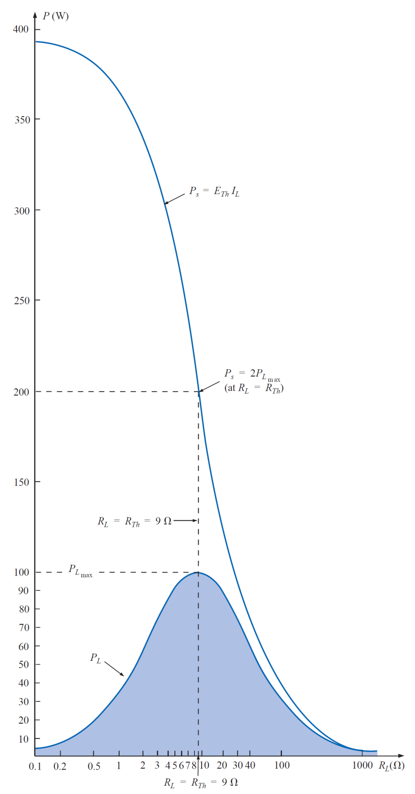
Efficiency and Maximum Power Transfer Theorem

Slide 19
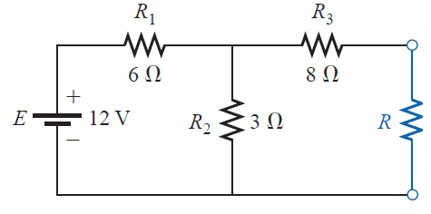

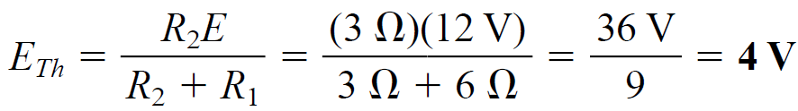
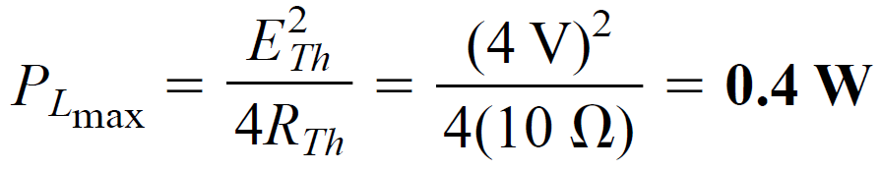
Maximum Power Transfer Theorem
Example
Determine the value of R for maximum power to R, and calculate the power delivered under these conditions.

